Slide 1
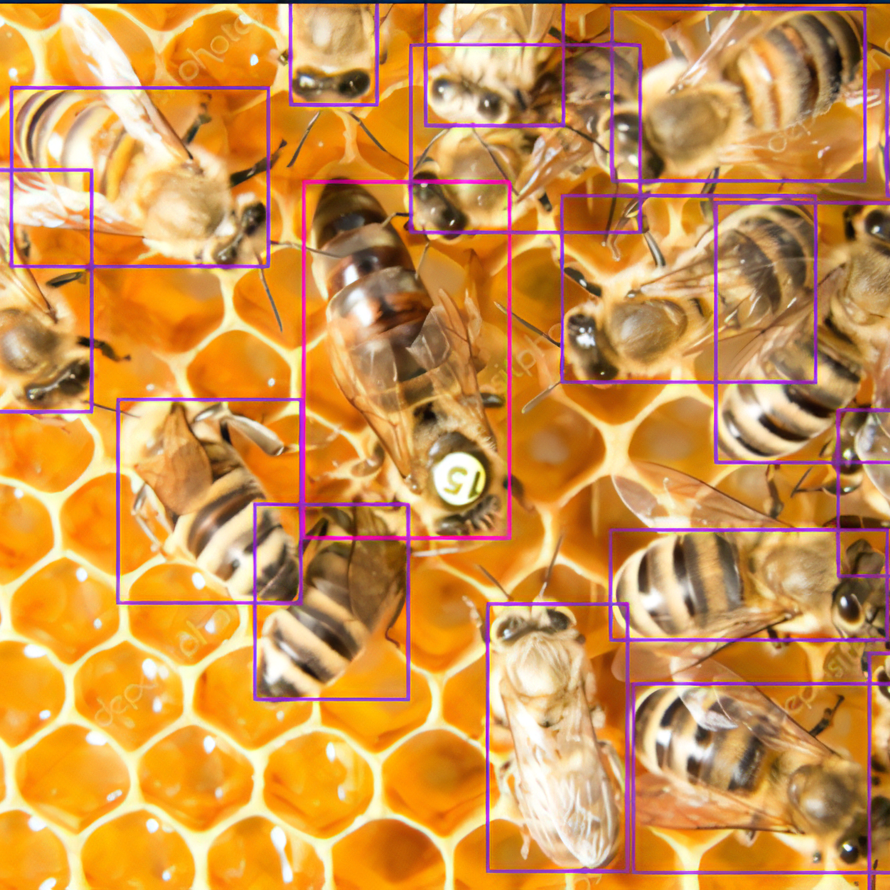
IDENTIFICATION OF DEFORMED WING VIRUS IN HONEY BEE

Slide 2
TEAM MEMBERS
K.venu gopal
T.Abhinav
E.lavanya
G.Shasank
TEAM NO:-VH187

Slide 3
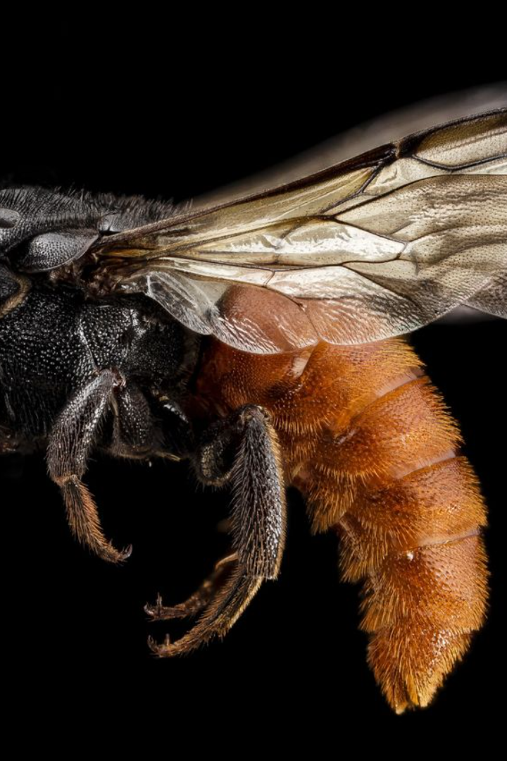
Problem statement:
Predicting Honey Bee Health through Wing Detection:
Honey bee health prediction plays a vital role in ensuring the well-being of these pollinators. By detecting the presence of wings, we can accurately assess their health status.

Slide 4
INTRODUCTION:
Finding and eliminating the dangerous DWV virus in individual bees as well as entire colonies is essential.
Training algorithms on image datasets of infected vs. healthy bees can provide predictive models to classify bees based on visual cues such wing deformities.
Additionally, algorithms are capable of identifying behavioral or auditory clues indicative of a viral disease.
These models have the potential to provide quick, hands-off DWV monitoring in the field when applied to footage from internal cameras or hive entrances.

Slide 5
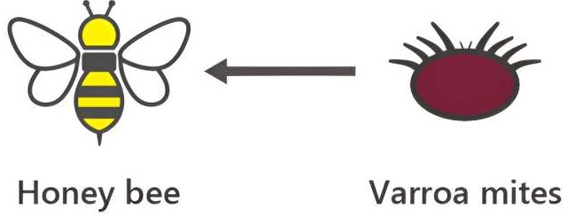
OBJECTIVES
To develop a computer vision that can accurately predict the affected or healthy bee.
Our objective is to develop a web page that can recognize the presence of the deformed wing virus (DWV) in bees automatically.
In order to "train" this computer to distinguish between sick and healthy bee wings, we will show it a ton of pictures. To develop this software, we will use popular machine learning libraries such as TensorFlow.

Slide 6

Honey Bee Health: Why It Matters
Vital Role
Ecosystem Balance
Healthy honey bees are crucial for maintaining biodiversity and ensuring food production through pollination.
A decline in honey bee health can disrupt entire ecosystems, affecting both plants and animals.
Economic Impact
Honey bees contribute billions of dollars to the global economy through pollination services.

Slide 7
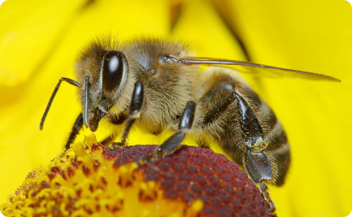
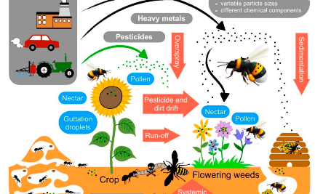
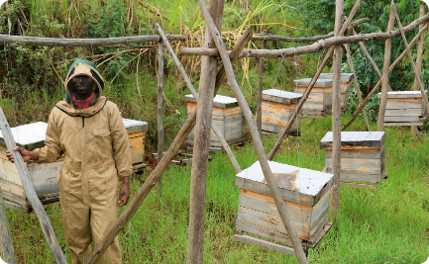
The Benefits of Predicting Honey Bee Health
Enhanced Pollination
Ecosystem Resilience
Economic Prosperity
By ensuring the health of honey bees, we promote effective pollination, leading to increased crop yields.
Healthy honey bees contribute to the resilience and stability of ecosystems, supporting biodiversity.
By securing honey bee populations, we safeguard the economic benefits derived from pollination services.

Slide 8
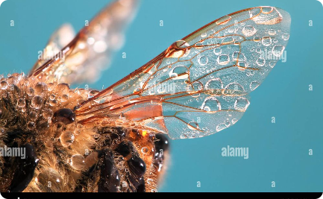

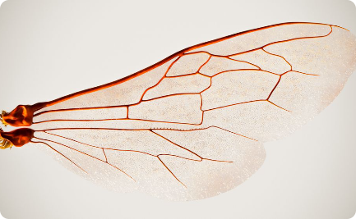
Detecting Honey Bee Wings
High-Resolution Imaging
Automated Wing Detection
Machine Learning
We use advanced imaging techniques to capture detailed images of honey bee wings.
Machine learning models are trained to recognize healthy and damaged wing patterns.
Sophisticated algorithms analyze the images to identify and isolate honey bee wings.

Slide 9

The Power of Wings: Determining Health
1
Indicator of Vitality
2
Quality of Flight
Healthy honey bees possess intact wings, while damaged wings may indicate underlying health issues.
Intact wings enable honey bees to fly efficiently, while impaired wings affect their mobility and foraging capabilities.
3
Age Assessment
By observing wing wear patterns, we can estimate the age of honey bees, which aids in understanding population dynamics.

Slide 10

Identifying Healthy Bees with Wings
1
Wing Integrity
Healthy honey bees exhibit symmetrical and undamaged wings, a sign of their optimal health.
2
Wing Vein Analysis
Examining the intricate network of wing veins provides insights into the overall condition of honey bees.
3
Color and Pigmentation
Distinctive coloration and pigment distribution on wings indicate robust bee health and genetic diversity.

Slide 11
LITERATURE SURVEY:
RESEARCH PAPER | AUTHOR | YEAR PUBLISHED | MODEL USED
Evaluating classification and feature selection techniques for honeybee subspecies identification using wing images. | Felipe Leno da Silva, Marina Lopes Grassi Sella, Tiago Mauricio Francoy, Anna Helena Reali Costa. | 17 March 2015 | Naive Bayes, K-Nearest Neighbor , Logistic Regression
Deformed Wing Virus in Honeybees and Other Insects | Stephen J. Martin, Laura E. Brettell | June 11, 2019
Honey Bee Colony Population Daily Loss Rate Forecasting and an Early Warning Method Using Temporal Convolutional Networks | Thi-Nha Ngo, Dan Jeric Arcega Rustia , En-Cheng Yang and Ta-Te Lin | 4 June 2021 | Temporal Convolutional Networks
Deformed wing virus type A, a major honey bee pathogen, is vectored by the mite Varroa destructor in a non propagative manner | Francisco Posada-Florez, Anna K. Childers , Matthew C. Heerman, Noble I. Egekwu, Steven C. Cook , YanpingChen, Jay D. Evans & EugeneV. Ryabov | 27 AUGUST 2019 | RT-qPCR Method

Slide 12
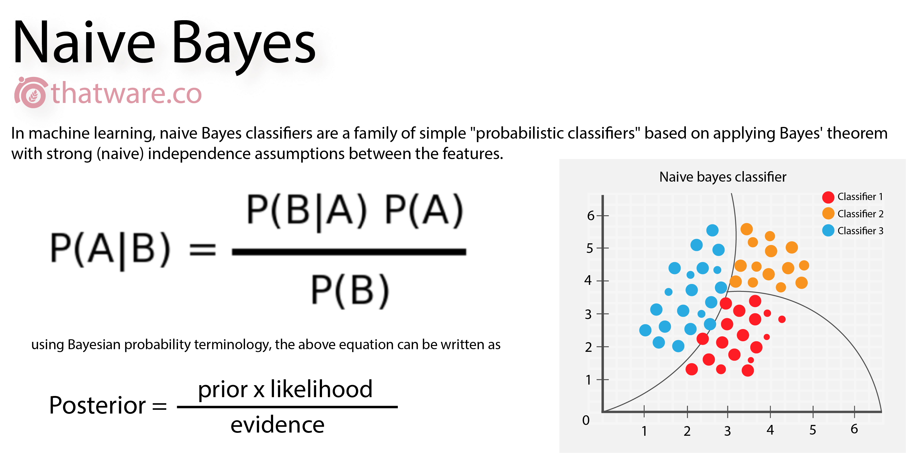
EXISTING METHODOLOGIES
Naive Bayes Algorithm for Classification:
Probabilistic Classification
Naive Bayes is a probabilistic classifier based on Bayes' theorem with an assumption of independence between predictors. It is particularly effective for tasks with a large number of features.

Slide 13
A is a vector containing a bee's feature values, such as wing size and virus load.
B is a binary variable that indicates the infection status of the bee (1 = DWV Positive, 0 = DWV Negative).
The posterior probability, P(B|A), that the bee is DWV positive or negative given its collection of feature values is determined by the Naive Bayes formula. Applying the Bayes Rule:
P(B|A) is equal to P(A|B) * P(B) / P(A).
P(B=1) = the training data-based prior probability that the bee is infected
The probability of feature values is P(A|B=1). The bee A is infected.
P(A) is the feature values' marginal probability.
For a particular bee with feature set A, we would compute and compare the following in order to create a classifier:
P(Y=1|A) as opposed to P(Y=0|A)

Slide 14
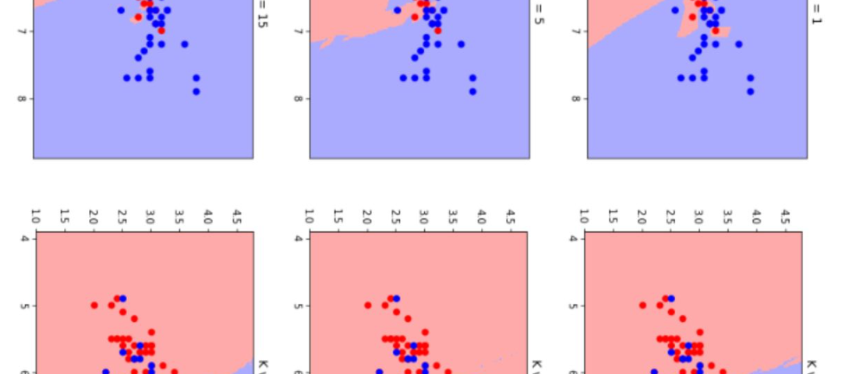

Applying K-Nearest Neighbor for Deformed Wing Virus Detection
K-nearest neighbor algorithm can be used to identify geospatial clusters of DWV-infected bee colonies, aiding in targeted interventions and control measures.
It assists in forecasting the possibility of DWV outbreaks by using the gathered data.
Logistic Regression

Slide 15
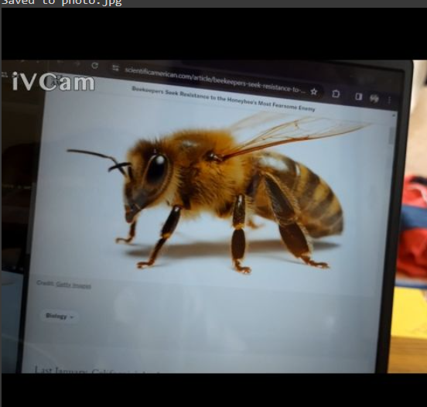
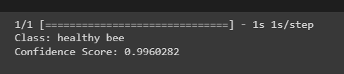
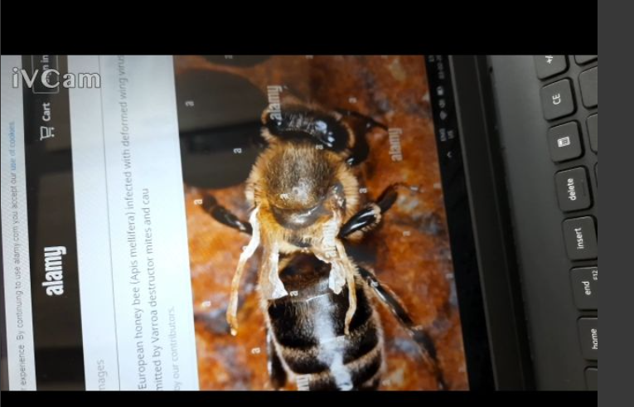
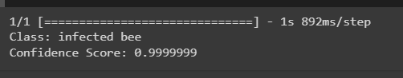
PROPOSED METHODOLOGY
INPUT IMAGES
OUTPUT RESULTS IN COLAB
CAPTURED THROUGH IVCAM
CAPTURED THROUGH IVCAM

Slide 16
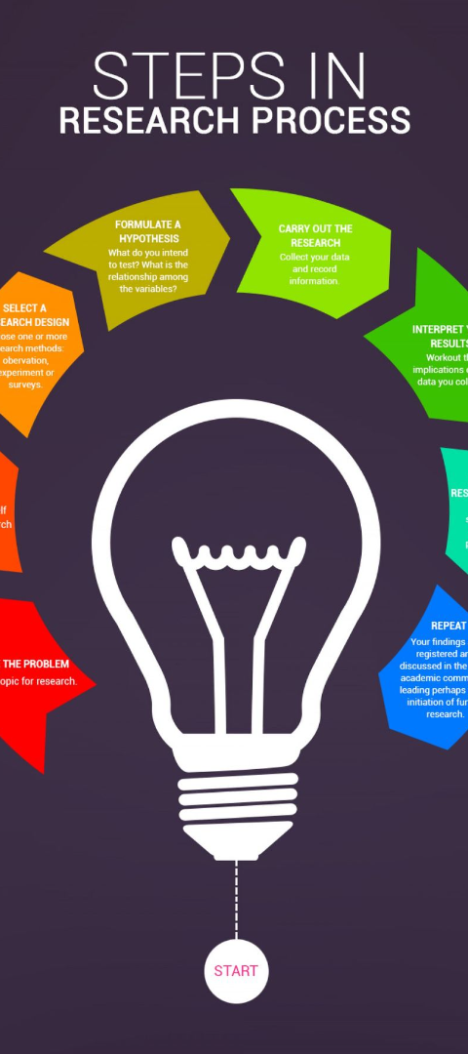
Creating a Web Page for the Project
1
Content Planning
Initial stages involving the planning and structuring of web content to present the research effectively.
2
Design & Development
The process of creating an engaging and user-friendly interface to host information and engage with the audience.
3
Testing & Optimization
Detailing the testing phase and optimization strategies to ensure seamless user experience and accessibility.

Slide 17
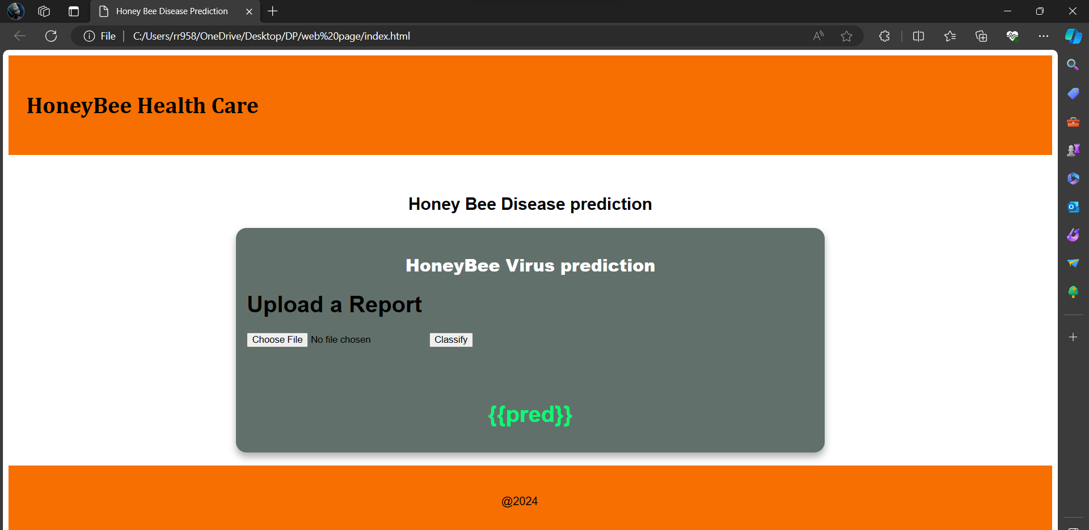

Slide 18

Conclusion and Future Implications
Research Advancements
Educational Outreach
Continued research in honey bee health prediction can lead to new insights and innovative solutions for bee conservation.
Spreading awareness about honey bee health can inspire individuals to take action and promote sustainable practices.
Policies
setting up and Implementing a web application to simplify the process of identifying the health of honey bees.

